Slide 1
Digital Portfolio
STUDENT NAME: SIVASRIRAM.C
REGISTER NO AND NMID:222407880 AND B51C7DF9CA0F539B1F54E6A11A35208D
DEPARTMENT: BSC COMPUTER SCIENCE AND DATA SCIENCE
COLLEGE: TAGORE COLLEGE OF ARTS AND SCIENCE/
UNIVERSITY OF MADRAS

Slide 2
PROJECT TITLE
EASYKID SEARCH

Slide 3


AGENDA
Problem Statement
Project Overview
End Users
Tools and Technologies
Portfolio design and Layout
Features and Functionality
Results and Screenshots
Conclusion
Github Link
3/21/2024 Annual Review

Slide 4

PROBLEM STATEMENT
Kids and beginners struggle to find safe, simple, and quick information.Wikipedia is good but too detailed and not kid-friendly.Games are hugely popular, but their info isn’t available in simple format online.

Slide 5

PROJECT OVERVIEW
Create a kid-friendly search engine.
Provide short, clean, and useful information.
Support wikipedia results

Slide 6

WHO ARE THE END USERS?
Students
faculties
users

Slide 7

TOOLS AND TECHNIQUES
Frontend: HTML, CSS
Logic & API calls: JavaScript
APIs:
Wikipedia REST API
Google Play Unofficial API
Fonts & Design: Google Fonts (Orbitron, Share Tech Mono

Slide 8
DESIGN AND LAYOUT
User opens Welcome Page (Portfolio).
Click “Enter Project” → goes to Search Page.
Enter search term:
If general topic → Wikipedia summary + image.
If game name → Play Store API info.
8

Slide 9
FEATURES AND FUNCTIONALITY
Welcome Portfolio Page (project intro + developer info).
Search Page with clean UI.
Wikipedia Integration → quick intro + image.
Game Info Integration → title, rating, installs, description (from Play Store API).About Section → explains purpose of the tools.

Slide 10
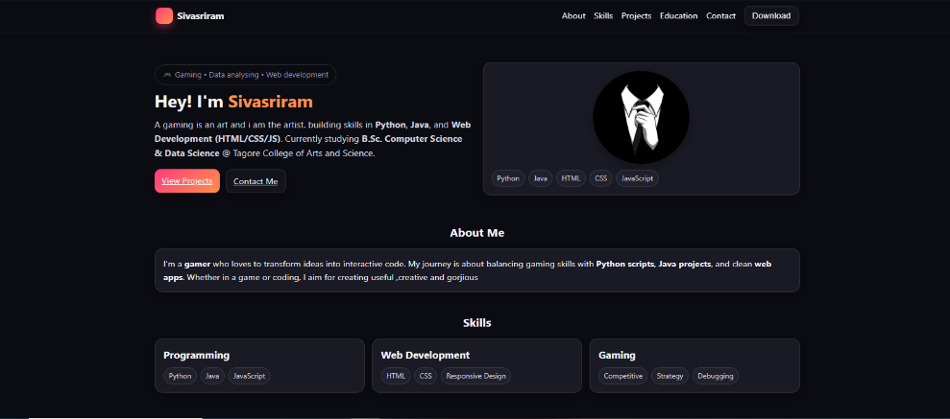
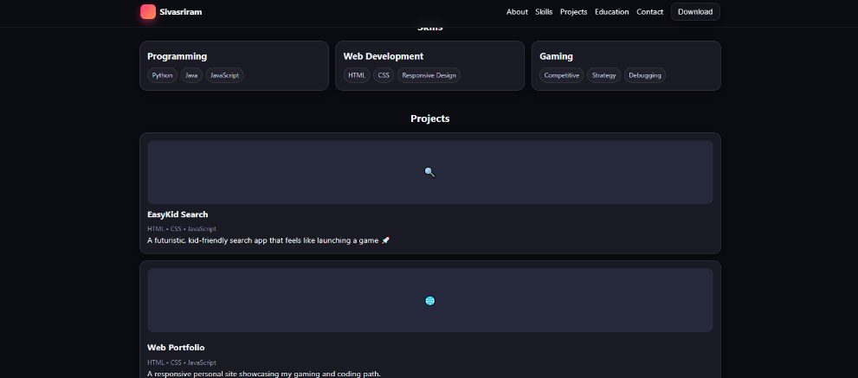
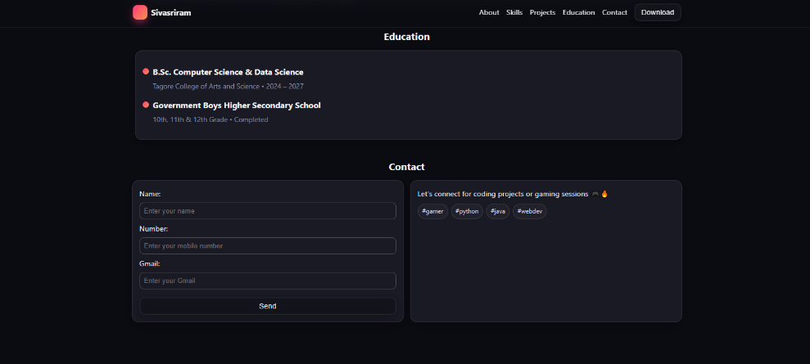
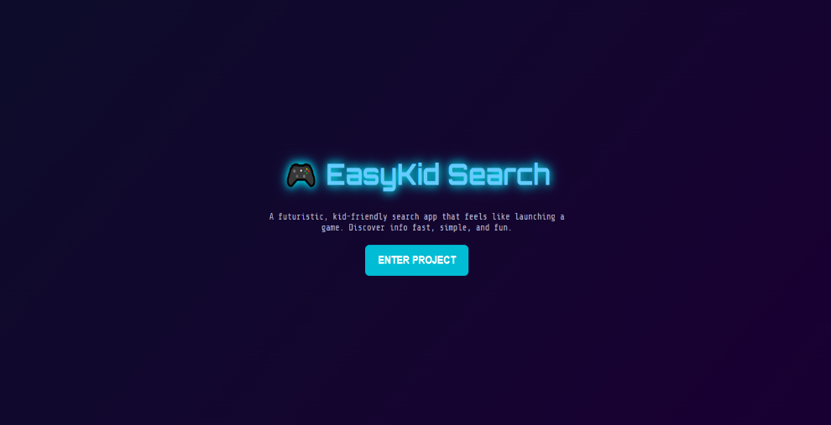
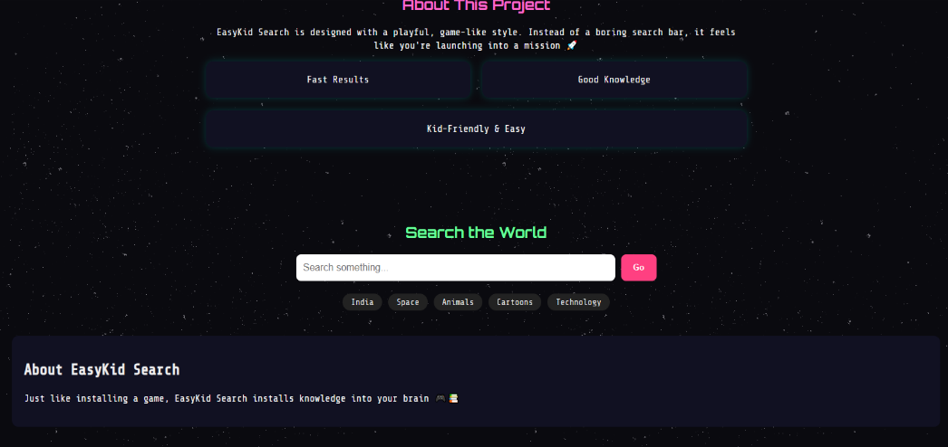
RESULTS AND SCREENSHOTS
3/21/2024 Annual Review
10

Slide 11
CONCLUSION
EasyKid Search solves the problem of
providing safe, quick, and engaging info.Brings Wikipedia + Game info together in a fun, digitalized way.A strong base project to expand into learning + entertainment platform.
11

